Slide 1
Linear Regression

Slide 2
Machine Learning Basic Terminology

Slide 3
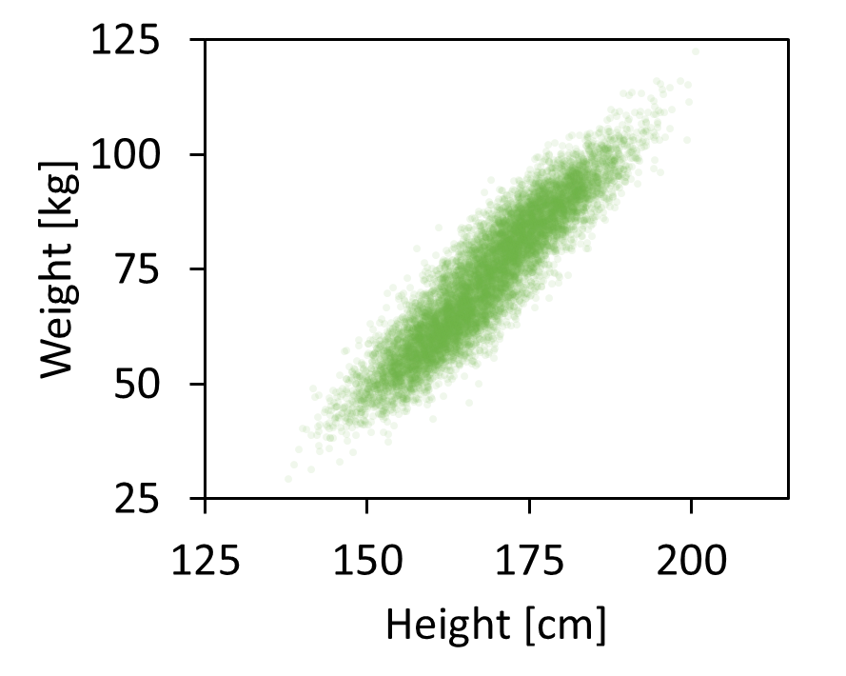
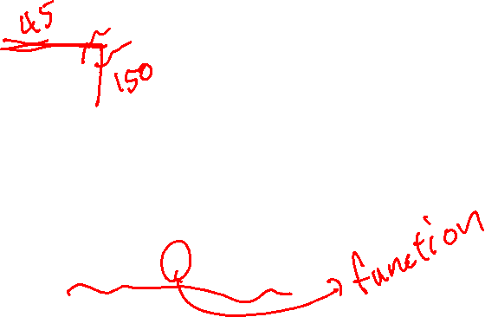
Supervised Learning
Predict weight given height
Right answers are given and are learned
weight = f(height)

Slide 4
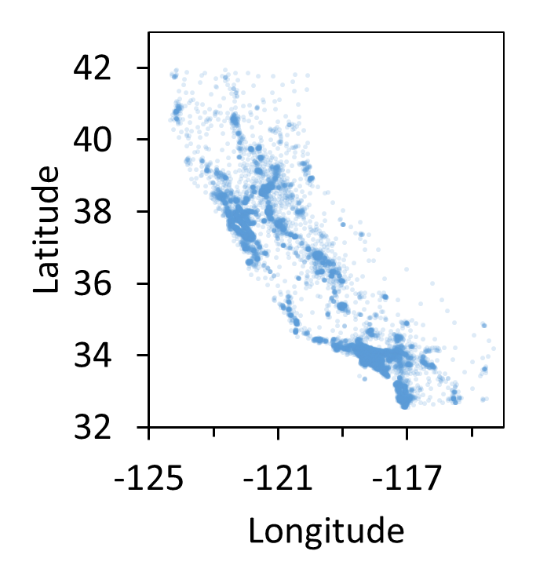
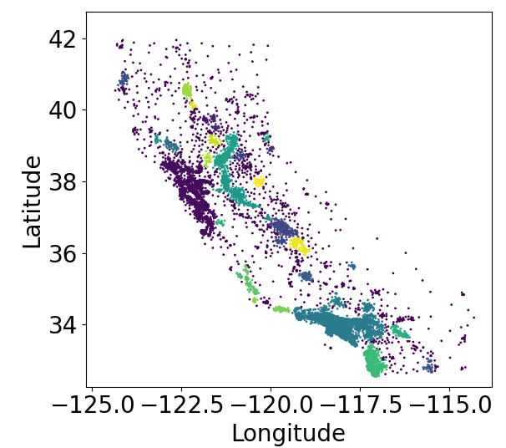
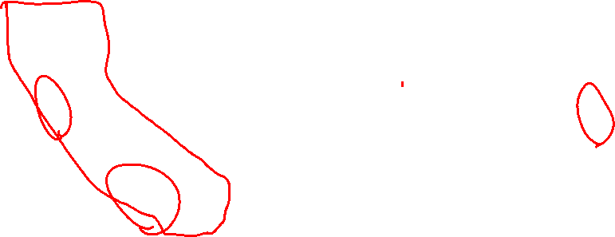
Unsupervised Learning
California Zip code distribution
Find clusters in Data
Sacramento
San Francisco
Los Angeles
San Diego
Find patterns in the data

Slide 5
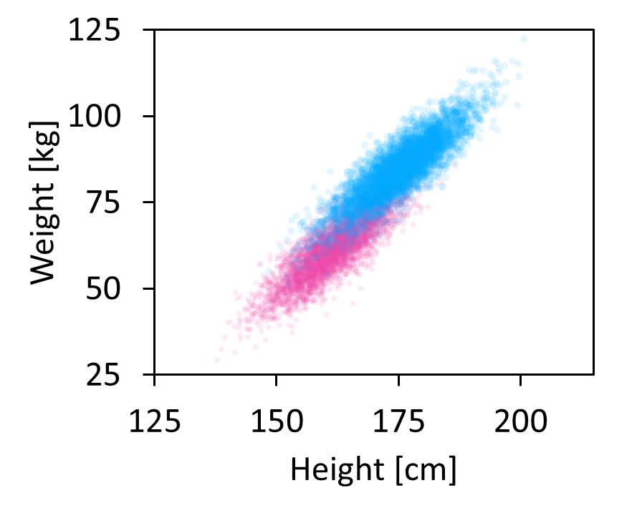

Supervised Learning: Regression and Classification
Predict weight
Predict gender
Male
Female
Regression
Continuous output (Weight)
Classification
Discreet output (0 - Male, 1 - Female)

Slide 6
Linear Regression

Slide 7
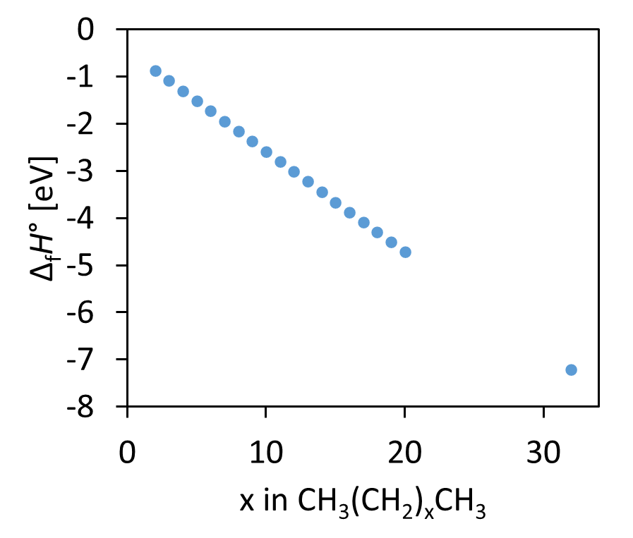
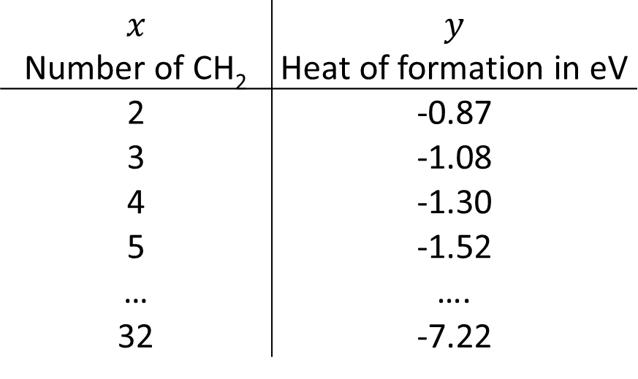
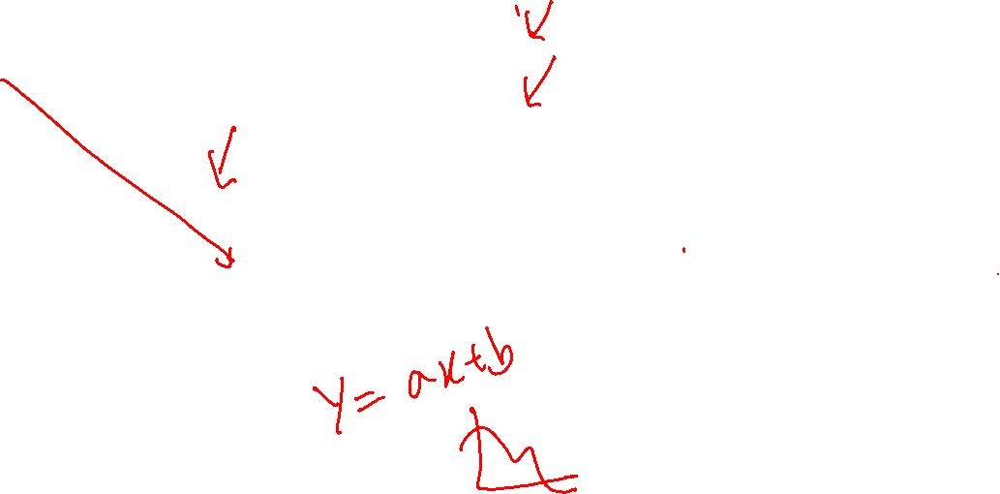
Linear Model Example in Chemistry
Heat of Formation, Δ_{f}H°, of Linear Alkane
Data
$$x$$ Number of CH₂ | $$y$$ Heat of formation in eV
2 | -0.87
3 | -1.08
4 | -1.30
5 | -1.52
… | ….
32 | -7.22

Slide 8
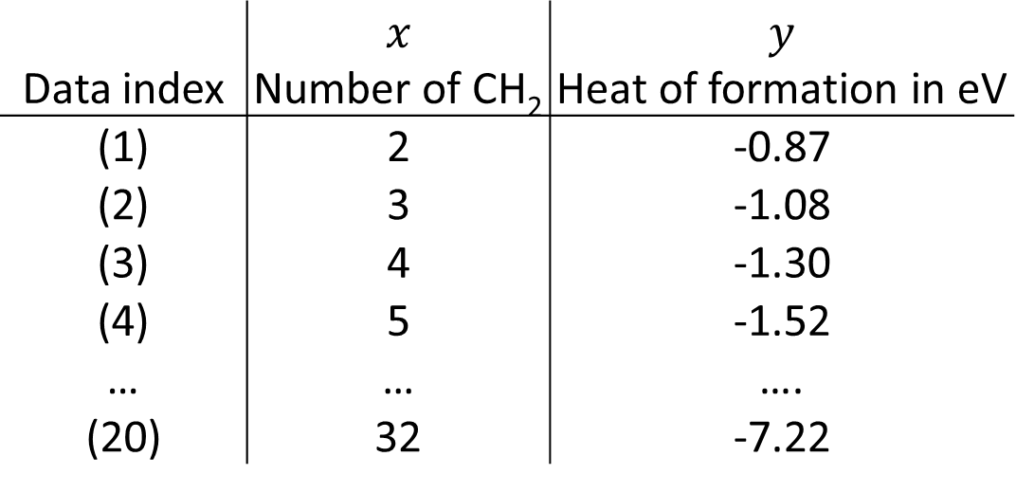
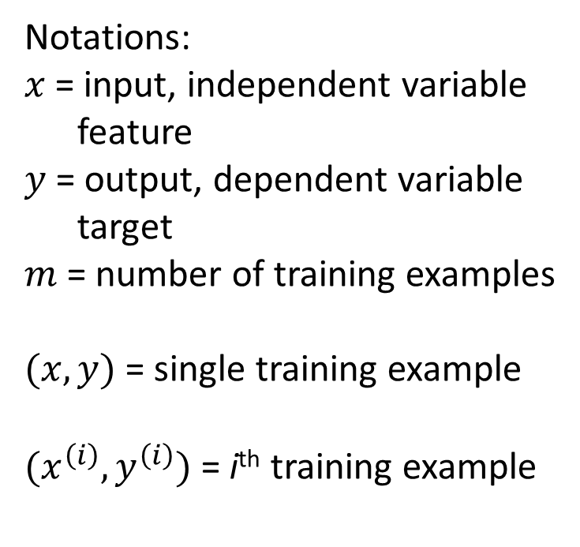
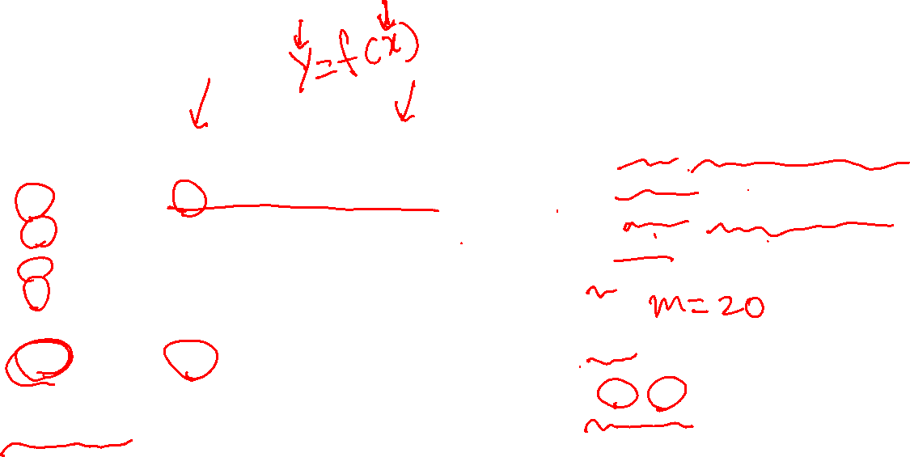
Terminology
Notations:
$x$ = input, independent variable
feature
$y$ = output, dependent variable
target
$m$ = number of training examples
$(x, y)$= single training example
$(x^{\left(i\right)}, y^{\left(i\right)})$ = i^{th} training example
Data index | $$x$$ Number of CH₂ | $$y$$ Heat of formation in eV
(1) | 2 | -0.87
(2) | 3 | -1.08
(3) | 4 | -1.30
(4) | 5 | -1.52
… | … | ….
(20) | 32 | -7.22
Training Set: Data used to train the model

Slide 9
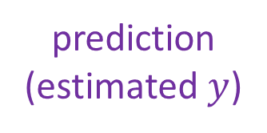
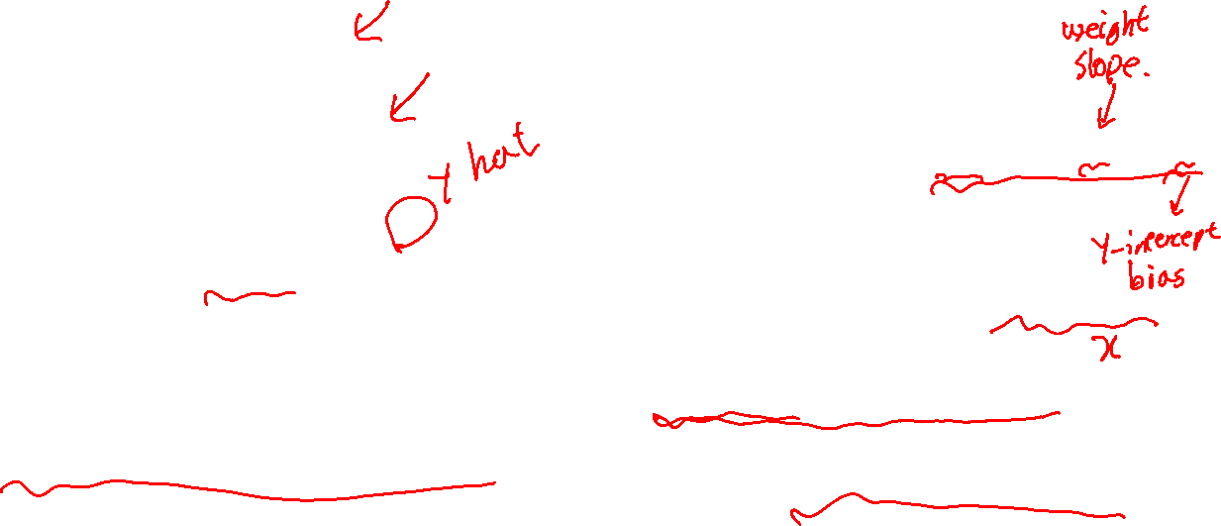

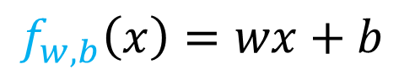
Linear Regression
How to represent f?
Training Set
Learning Algorithm
$$f_{w,b}\left(x\right)=wx+b$$
x
f
$$\hat{y}$$
feature
function
prediction
(estimated $y$)
Linear regression with one variable
Univariate linear regression
Number of CH₂
Heat of formation
f
what does w and b do?

Slide 10
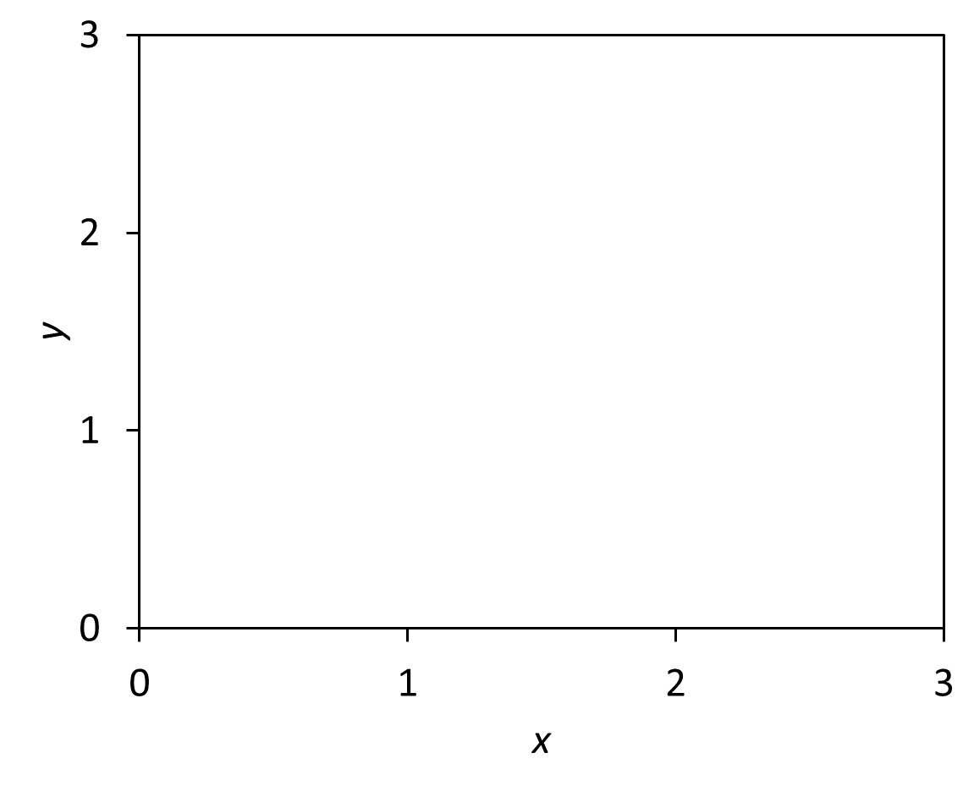
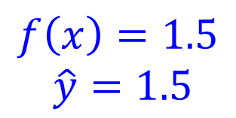
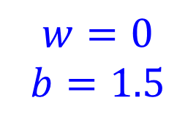
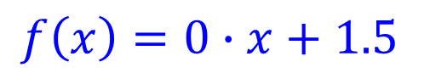
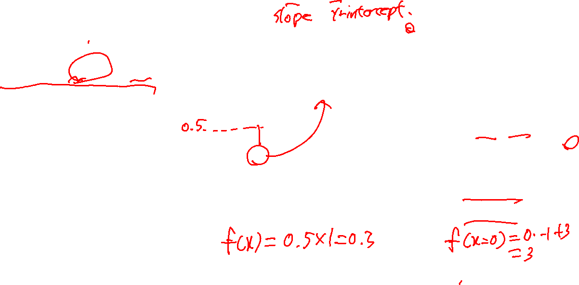
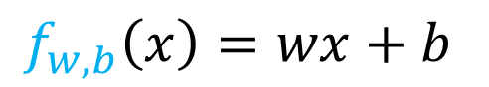
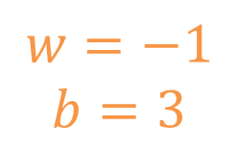
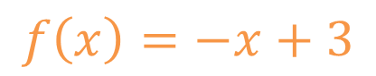
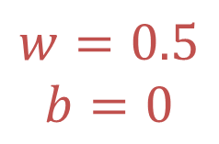
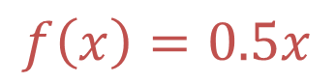
Model Parameters
$$f_{w,b}\left(x\right)=wx+b$$
$$f\left(x\right)=0∙x+1.5$$
$$f\left(x\right)=0.5x$$
$$f\left(x\right)=1.5$$
$$\hat{y}=1.5$$
$$f\left(x\right)=−x+3$$
$$w=0$$
$$b=1.5$$
$$w=0.5$$
$$b=0$$
$$w=−1$$
$$b=3$$

Slide 11
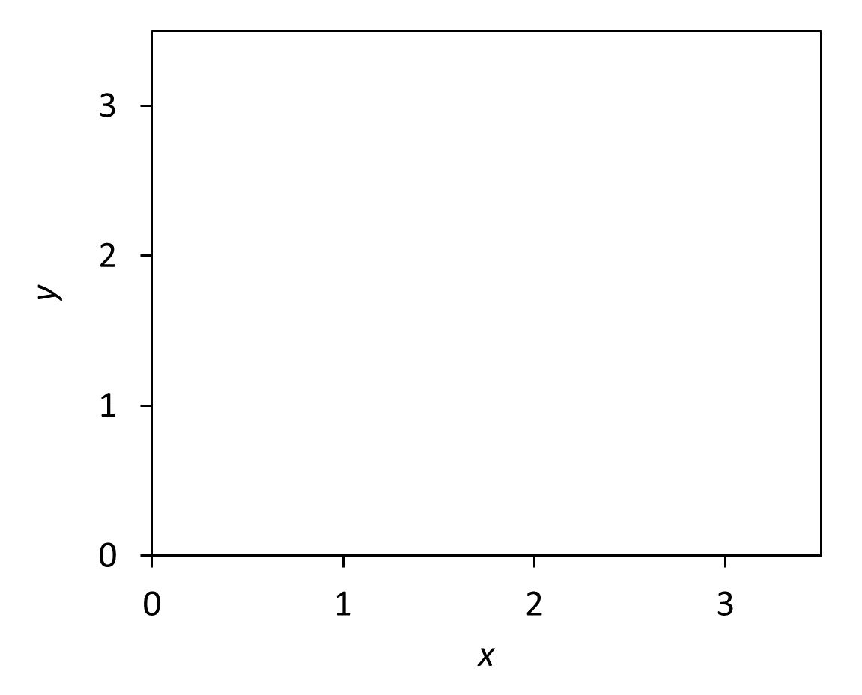
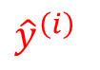

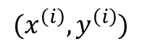
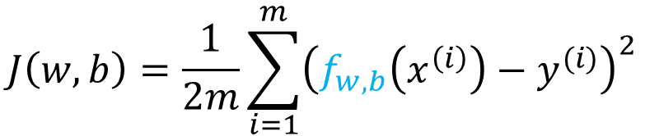
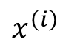
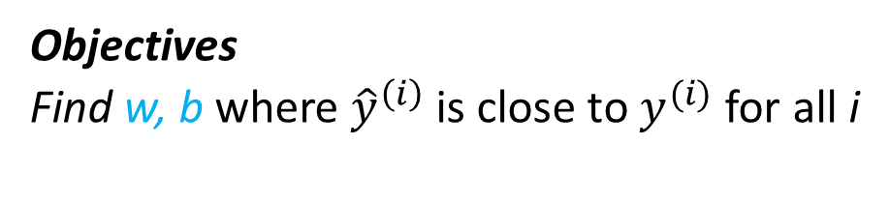
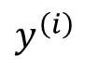
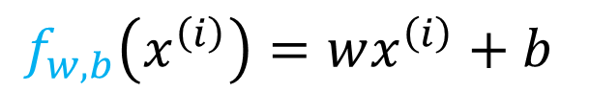
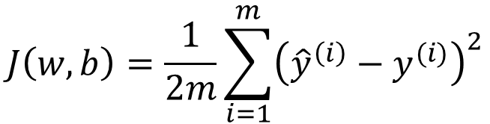
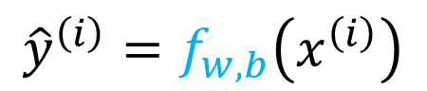
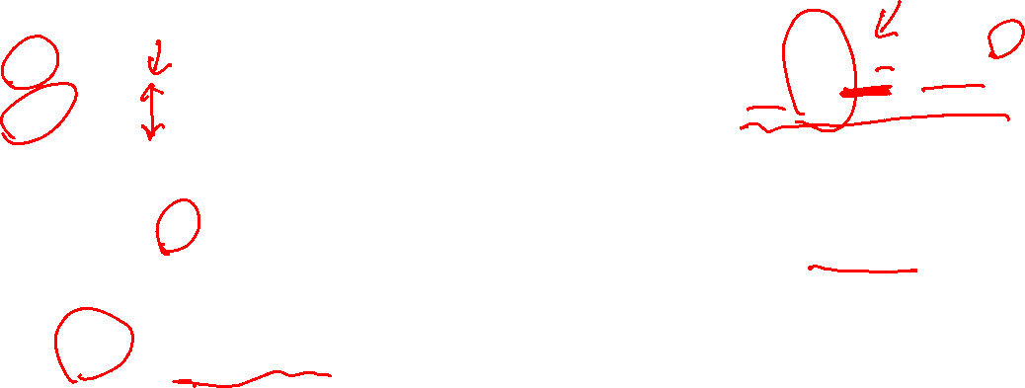
Measure of Fitness - Cost Function
How good is the f_{w,b}?
How far is the ${\hat{y}}^{\left(i\right)}$from points?
Squared error function
$(x^{\left(i\right)}, y^{\left(i\right)})$
f_{w,b}
$$J\left(w,b\right)=\frac{1}{2m}\sum_{i=1}^{m}{{\left({\hat{y}}^{\left(i\right)}−y^{(i)}\right)}^{2}}$$
$$y^{\left(i\right)}$$
$${\hat{y}}^{\left(i\right)}$$
m = Number of training examples
$$J\left(w,b\right)=\frac{1}{2m}\sum_{i=1}^{m}{{\left(f_{w,b}\left(x^{\left(i\right)}\right)−y^{(i)}\right)}^{2}}$$
$$x^{\left(i\right)}$$
$${\hat{y}}^{\left(i\right)}=f_{w,b}\left(x^{\left(i\right)}\right)$$
Objectives
Find w, b where ${\hat{y}}^{\left(i\right)}$ is close to $y^{(i)}$ for all i
$$f_{w,b}\left(x^{\left(i\right)}\right)=wx^{\left(i\right)}+b$$

Slide 12
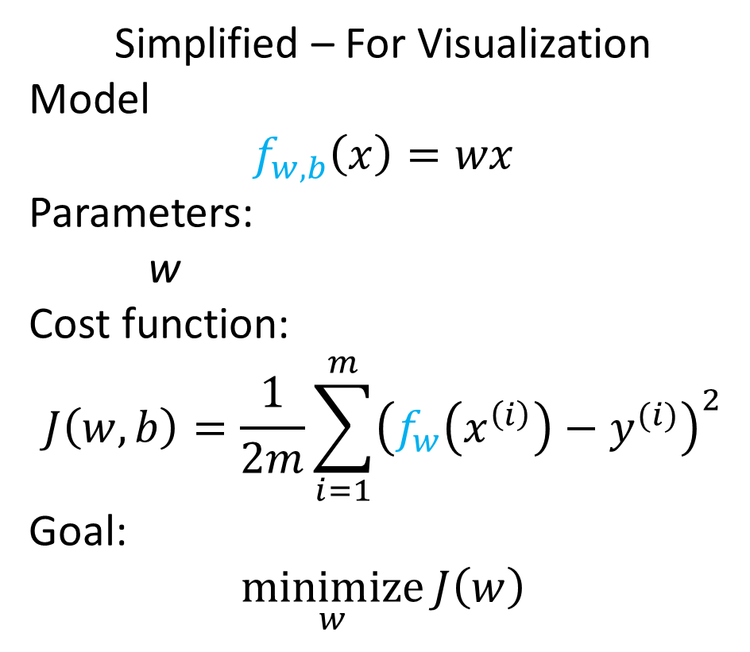
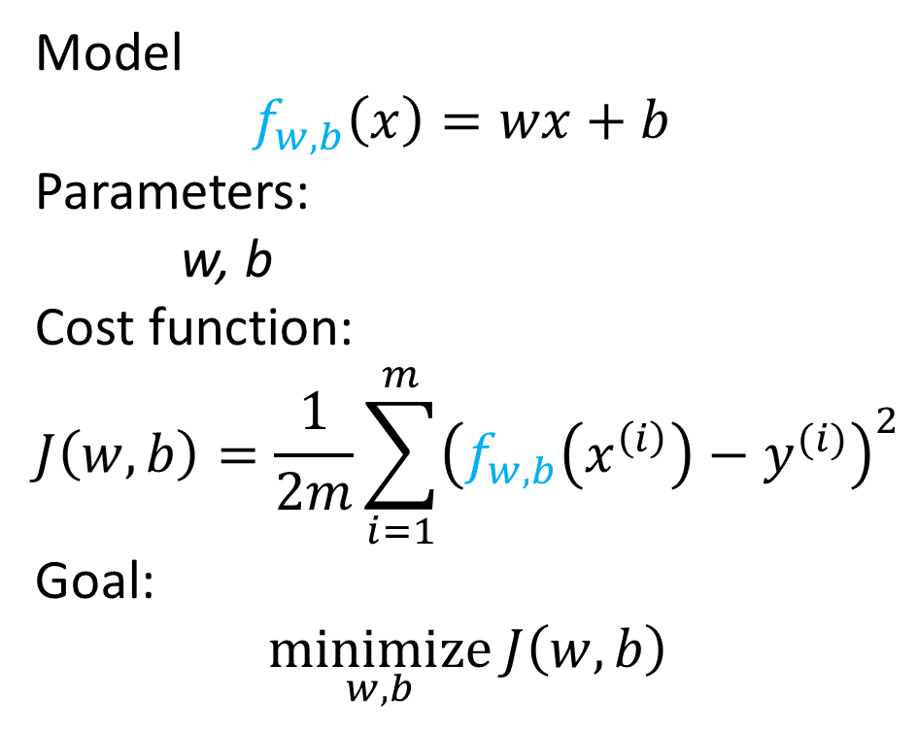
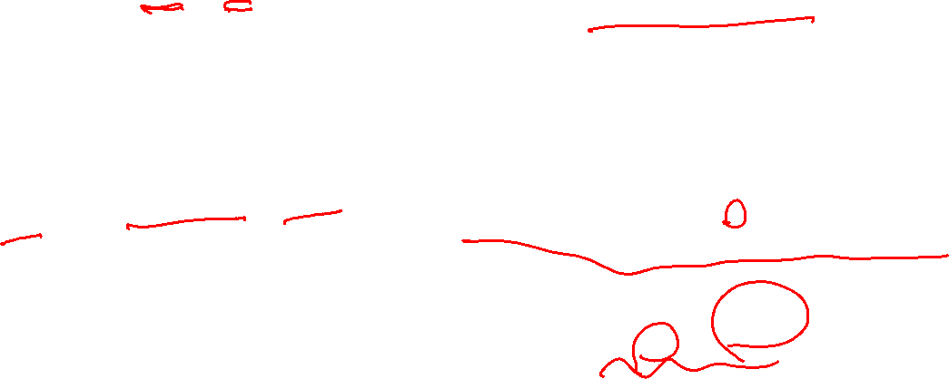
Summary
Simplified – For Visualization
Model $$f_{w,b}\left(x\right)=wx$$
Parameters:
w
Cost function:
$$J\left(w,b\right)=\frac{1}{2m}\sum_{i=1}^{m}{{\left(f_{w}\left(x^{\left(i\right)}\right)−y^{(i)}\right)}^{2}}$$
Goal:
$$\underset{w}{minimize}{J\left(w\right)}$$
Model $$f_{w,b}\left(x\right)=wx+b$$
Parameters:
w, b
Cost function:
$$J\left(w,b\right)=\frac{1}{2m}\sum_{i=1}^{m}{{\left(f_{w,b}\left(x^{\left(i\right)}\right)−y^{(i)}\right)}^{2}}$$
Goal:
$$\underset{w,b}{minimize}{J\left(w,b\right)}$$

Slide 13


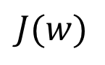
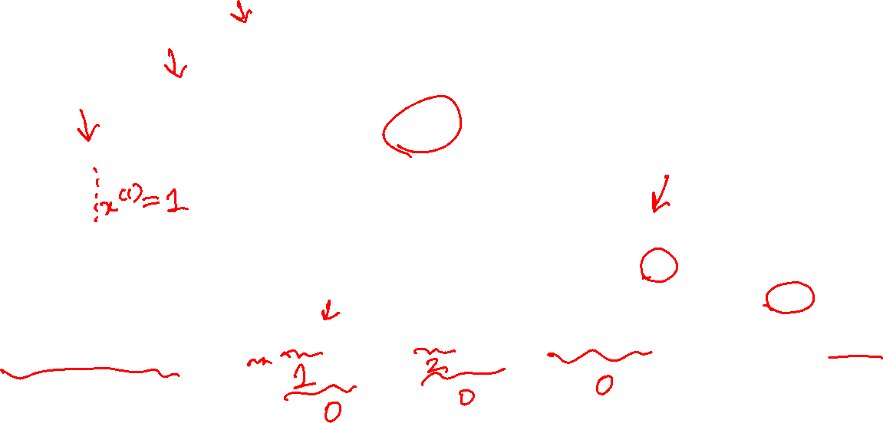
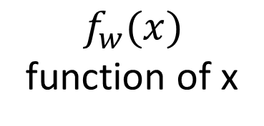
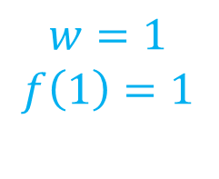
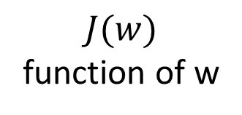
Measure of Fitness - Cost Function
$$f_{w}(x)$$
function of x
$$J(w)$$
function of w
3
$$f_{w}$$
2
$$w=1$$
$$f\left(1\right)=1$$
$$J(w)$$
1
0
-1
0
1
2
3
$$w$$
$$J\left(w\right)=\frac{1}{2m}\sum_{i=1}^{m}{{\left(f_{w}\left(x^{i}\right)−y^{i}\right)}^{2}}=\frac{1}{2∙3}\left[{\left(wx^{(1)}−1\right)}^{2}+{\left(wx^{(2)}−2\right)}^{2}+{\left(wx^{(3)}−3\right)}^{2}\right]=\frac{1}{2∙3}\left[0+0+0\right]=0$$

Slide 14

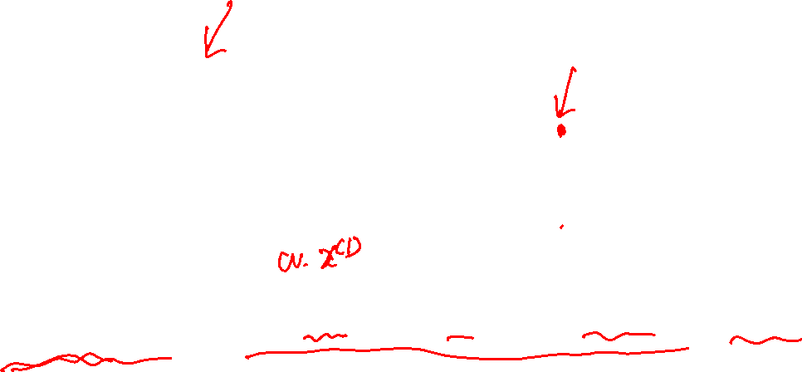
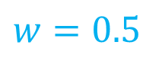
Measure of Fitness - Cost Function
$$f_{w}(x)$$
function of x
$$J(w)$$
function of w
3
2
$$f_{w}$$
$$J(w)$$
1
$$w=0.5$$
0
-1
0
1
2
3
$$w$$
$$J\left(w\right)=\frac{1}{2m}\sum_{i=1}^{m}{{\left(f_{w}\left(x^{i}\right)−y^{i}\right)}^{2}}=\frac{1}{2∙3}\left[{\left(0.5−1\right)}^{2}+{\left(1−2\right)}^{2}+{\left(1.5−3\right)}^{2}\right]≈0.583$$

Slide 15

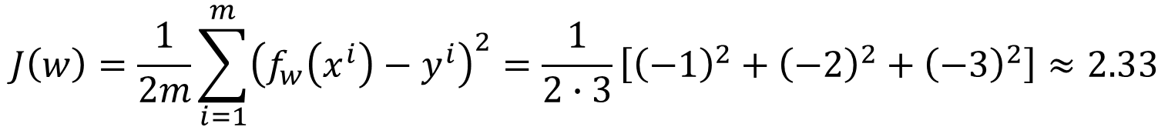

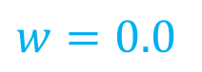
Measure of Fitness - Cost Function
$$f_{w}(x)$$
function of x
$$J(w)$$
function of w
3
2
$$J(w)$$
1
$$w=0.0$$
$$f_{w}$$
0
-1
0
1
2
3
$$w$$
$$J\left(w\right)=\frac{1}{2m}\sum_{i=1}^{m}{{\left(f_{w}\left(x^{i}\right)−y^{i}\right)}^{2}}=\frac{1}{2∙3}\left[{\left(−1\right)}^{2}+{\left(−2\right)}^{2}+{\left(−3\right)}^{2}\right]≈2.33$$

Slide 16

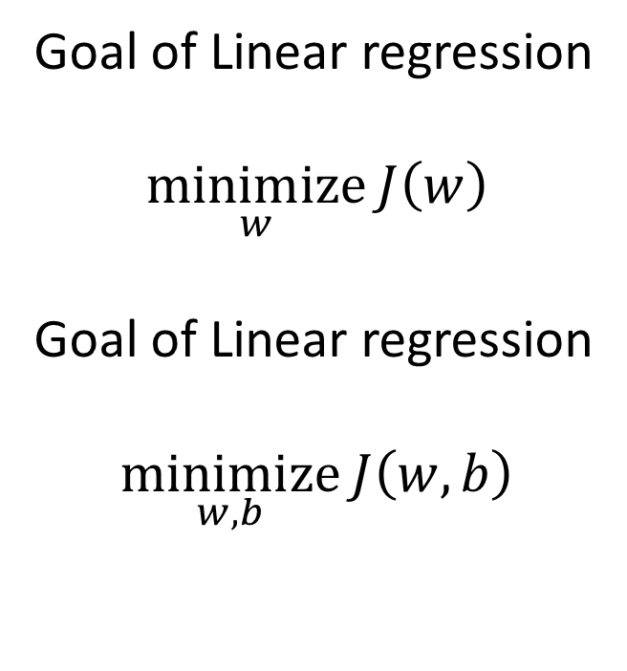
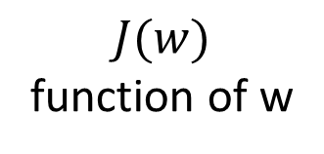
Measure of Fitness - Cost Function
$$J(w)$$
function of w
3
Goal of Linear regression
$$\underset{w}{minimize}{J\left(w\right)}$$
Goal of Linear regression
$$\underset{w,b}{minimize}{J\left(w,b\right)}$$
2
$$J(w)$$
1
0
-1
0
1
2
3
$$w$$

Slide 17






Now including the bias
f_{w,b}
J for f_{w,b}
(function of w and b)
$$f_{w,b}\left(x\right)=−\frac{1}{6}x−3$$

Slide 18





Slide 19







Cost Function 2D
$$w =−0.5$$
$$b = 7.5$$
$$w =−0.21$$
$b =−0.$46
$$w =−1$$
$$b =−0.2$$
$$w =2$$
$$b =−2.5$$
$$w =0.3$$
$$b =−8$$

Slide 20
Gradient Descent

Slide 21

Gradient Descent
Have some function $J\left(w,b\right)$
Want $\min_{w,b}{J\left(w,b\right)}$
Steps:
Start with some w, b
Keep changing w, b to reduce $J\left(w,b\right)$
Until we settle at or near a minimum

Slide 22





Gradient Descent
$$J\left(w,b\right)$$
$$b$$
$$w$$

Slide 23




Gradient Descent Algorithm
Given a cost function $J\left(w,b\right)$
We want
$$\min_{w,b }{J\left(w,b\right)}$$
Learning Rate
Algorithm:
repeat until convergence{
$$w_{tmp}=w−α\frac{∂}{∂w}J\left(w,b\right)$$
$$b_{tmp}=b−α\frac{∂}{∂b}J\left(w,b\right)$$
$$w=w_{tmp}′$$
$$b=b_{tmp}′$$
}

Slide 24




Partial Derivative
$$J\left(w,b\right)=\frac{1}{2m}\sum_{i=1}^{m}{{\left(f_{w}\left(x^{\left(i\right)}\right)−y^{(i)}\right)}^{2}}$$
$$\frac{∂}{∂w}J\left(w,b\right)$$
$$\frac{∂}{∂b}J\left(w,b\right)$$

Slide 25


Gradient Descent Algorithm
Given a cost function $J\left(w,b\right)$
We want
$$\min_{w,b }{J\left(w,b\right)}$$
Algorithm:
repeat until convergence{
$$w_{tmp}=w−α\frac{1}{m}\sum_{i=1}^{m}{\left(f_{w,b}\left(x^{(i)}\right)−y^{(i)}\right)x^{(i)}}$$
$$b_{tmp}=b−α\frac{1}{m}\sum_{i=1}^{m}{\left(f_{w,b}\left(x^{(i)}\right)−y^{(i)}\right)}$$
$$w=w_{tmp}′$$
$$b=b_{tmp}′$$
}

Slide 26












Gradient Descent
$$w=w−α\frac{∂}{∂w}J\left(w\right)$$
$$J(w)$$
$$J(w)$$
$$\frac{∂}{∂θ}J\left(θ\right)>0$$
$$\frac{∂}{∂θ}J\left(θ\right)<0$$
$$α \frac{∂}{∂θ}J\left(θ\right)$$
$$α \frac{∂}{∂θ}J\left(θ\right)$$
$$\frac{∂}{∂θ}J\left(θ\right)$$
$$\frac{∂}{∂θ}J\left(θ\right)$$
w
w
$$w=w−α∙(negative number)$$
$$w=w−α∙(positive number)$$

Slide 27


Gradient Descent – Learning Rate
$$w=w−α\frac{∂}{∂w}J\left(w\right)$$
α too small
Gradient descent slow
α too large
Overshoot, never reach minimum
J
J
w
w

Slide 28


Gradient Descent – Local Minima
J
slope = 0
Local Minimum
w
$$w=w−α\frac{∂}{∂w}J\left(w\right)=w−α∙0=w$$

Slide 29

Multiple Solution
$$J\left(w,b\right)$$
$$b$$
$$w$$

Slide 30



Gradient Descent
$$w=w−α\frac{∂}{∂w}J\left(w\right)$$
$$J(w)$$
Near a local minimum,
- Derivative becomes smaller,
- Update steps become smaller
Can reach minimum without decreasing learning rate, $α$
w

